Slide 1

WSQ
COURSE
COURSE SLIDES · WSQ
Customer-Centric Branding and Communication Tactics
WSQ Course Code: TGS-2026061321
Conducted by Tertiary Infotech Academy Pte Ltd · UEN 201200696W
Version v2 · 7 August 2026
© 2026 Tertiary Infotech Academy Pte Ltd. All rights reserved. · www.tertiarycourses.com.sg

Slide 2
COURSE ADMINISTRATION
Welcome & Housekeeping
Customer-Centric Branding and Communication Tactics · TGS-2026061321
© 2026 Tertiary Infotech Academy Pte Ltd
1

Slide 3
SSG DIGITAL ATTENDANCE
Digital Attendance (Mandatory)
• It is mandatory to take the AM, PM and Assessment digital attendance for WSQ-funded courses.
• The trainer/administrator displays the digital attendance QR code from the SSG portal.
• Scan the QR code with your mobile phone camera and submit your attendance.
• A minimum of 75% attendance is required to be eligible for assessment and funding.
Customer-Centric Branding and Communication Tactics · TGS-2026061321
© 2026 Tertiary Infotech Academy Pte Ltd
2

Slide 4
YOUR TRAINER · GENERAL
About the Trainer
NAME
____________________________________________
?
TITLE / DESIGNATION
____________________________________________
QUALIFICATIONS
____________________________________________
Your Trainer
AREAS OF EXPERTISE
____________________________________________
General Trainer template — to be completed by the trainer
TRAINING & INDUSTRY EXPERIENCE
____________________________________________
CONTACT
____________________________________________
Customer-Centric Branding and Communication Tactics · TGS-2026061321
© 2026 Tertiary Infotech Academy Pte Ltd
3

Slide 5
YOUR TRAINER
About the Trainer
ROLE
Principal Trainer, Tertiary Infotech Academy Pte. Ltd.
AA
CERTIFICATION / CREDENTIALS
20+ years of training and industry experience.
Dr. Alfred Ang
DELIVERS
WSQ courses on customer-centric branding, marketing communications and business skills.
Principal Trainer Tertiary Infotech Academy Pte. Ltd.
FOUNDER
Founder and lead instructor at Tertiary Infotech / Tertiary Courses.
Customer-Centric Branding and Communication Tactics · TGS-2026061321
© 2026 Tertiary Infotech Academy Pte Ltd
4

Slide 6
ICE-BREAKER
Let's Know Each Other
• Your name and organisation / role.
• Your experience with branding, marketing or communications (if any).
• A brand you personally admire — and why it works on you.
Customer-Centric Branding and Communication Tactics · TGS-2026061321
© 2026 Tertiary Infotech Academy Pte Ltd
5

Slide 7
HOUSEKEEPING
Ground Rules
Set your mobile phone to silent mode.
Actively participate — no question is too small.
1
2
Respect each other's views: agree to disagree.
One conversation at a time.
3
4
Be punctual; return from breaks on time.
75% attendance is required for funding eligibility.
5
6
Customer-Centric Branding and Communication Tactics · TGS-2026061321
© 2026 Tertiary Infotech Academy Pte Ltd
6

Slide 8
COURSE ACCREDITATION
Skills Framework
TSC Title
Brand Management
TSC Code
ICT-SNM-3002-1.1
1
2
Proficiency Level
Level 3
Structure
4 Learning Units (LU1–LU4), each mapped to a Learning Outcome.
3
4
Customer-Centric Branding and Communication Tactics · TGS-2026061321
© 2026 Tertiary Infotech Academy Pte Ltd
7

Slide 9
4 LEARNING UNITS
Course Outline
LU1 — Stakeholders and Organisation
Internal & External Stakeholders · Audience Types · Brand Design · Reputation Assessment
LU2 — Customer Influence
Customer Perceptions · Brand Reputation · Campaign Reception · Active Listening
1
2
LU3 — Branding in Marketing
Branding Basics · Role in Marketing · Awareness Campaigns · PR Execution
LU4 — Branding Effectiveness
Reputation Metrics · Success Indicators · PR Tactics · KPI Monitoring · Continuous Improvement
3
4
Customer-Centric Branding and Communication Tactics · TGS-2026061321
© 2026 Tertiary Infotech Academy Pte Ltd
8

Slide 10
SCHEDULE
Lesson Plan — 2 Days
Day 1
Day 2 & Assessment
• Day 1 — Stakeholders, Customer Influence & Branding in Marketing (starts)
– LU1: Stakeholders and Organisation (Activities 1–4)
– LU2: Customer Influence (Activities 5–8)
– LU3: Branding in Marketing — begins (Activities 9–12)
• Day 2 — Branding in Marketing (cont'd), Branding Effectiveness & Assessment
– LU3: Branding in Marketing — continued
– LU4: Branding Effectiveness (Activities 13–17)
– Assessment: WA (1h) + Case Study (1h), 4:00–6:00pm
• Daily timing
– Day 1: 9:30am–6:30pm, 1-hour lunch. Day 2: 9:30am–6:00pm, 45-min lunch (to fit the assessment).
Customer-Centric Branding and Communication Tactics · TGS-2026061321
© 2026 Tertiary Infotech Academy Pte Ltd
9

Slide 11
WHAT YOU'LL ACHIEVE
Learning Outcomes
Stakeholders & Organisation
Identify stakeholders/audiences and draft branding designs & reputation assessments.
Customer Influence
Capture and analyse customer insight through active listening.
1
2
Branding in Marketing
Execute branding campaigns, events and PR activities that build awareness.
Branding Effectiveness
Evaluate reputation and PR performance against KPIs and recommend improvements.
3
4
Customer-Centric Branding and Communication Tactics · TGS-2026061321
© 2026 Tertiary Infotech Academy Pte Ltd
10

Slide 12
Briefing for Assessment
• Place phones and other materials under the table or on the floor.
• No photos or recording of assessment scripts.
• No discussion during the assessment.
• Use a black/blue pen for hard-copy assessments.
• No liquid paper / correction tape.
• Scripts are collected when time is up.
Customer-Centric Branding and Communication Tactics · TGS-2026061321
© 2026 Tertiary Infotech Academy Pte Ltd
11

Slide 13
FINAL ASSESSMENT
Assessment
• Written Assessment (WA) — Short-Answer Questions (SAQ), 1 hour, open book.
• Case Study (CS) — one continuous branding scenario with open-ended tasks, 1 hour, open book.
• Format: Open Book — slides, Learner Guide and approved materials only.
• A minimum of 75% attendance (per SSG Digital Attendance record) is required to be eligible for assessment and funding. Learners must be assessed as Competent and complete the TRAQOM survey.
• An appeal process is available if required.
Customer-Centric Branding and Communication Tactics · TGS-2026061321
© 2026 Tertiary Infotech Academy Pte Ltd
12

Slide 14
ON ASSESSMENT DAY
Assessment Flow
1
2
3
4
5
▶
▶
▶
▶
TRAQOM survey — scan the QR code on the LMS
Assessment digital attendance — scan the SSG QR
Sit WA (SAQ) then the Case Study — open book
Submit your answers on the LMS
Sign the Assessment Summary Record
Customer-Centric Branding and Communication Tactics · TGS-2026061321
© 2026 Tertiary Infotech Academy Pte Ltd
13

Slide 15
COURSE PORTAL
Courseware & Assessment on the LMS
Everything for the open-book assessment — slides, Learner Guide and submissions — lives on the LMS.
Sign in
Log in with your registered email (OTP or password).
1
Tertiary Infotech Academy
Download materials
Slides and the Learner Guide from the course page — your open-book references.
2
LMS and TMS for SSG courses
Submit answers
Upload your Written Assessment and Case Study answers on the LMS.
Sign in / OTP
3
lms-tms.tertiaryinfotech.com
TRAQOM survey
Complete the TRAQOM survey via the QR code shown on the LMS.
4
https://lms-tms.tertiaryinfotech.com/
Customer-Centric Branding and Communication Tactics · TGS-2026061321
© 2026 Tertiary Infotech Academy Pte Ltd
14

Slide 16
LU1
LU1
Stakeholders and Organisation
Internal & External Stakeholders · Audience Types · Brand Design · Reputation Assessment
Customer-Centric Branding and Communication Tactics · TGS-2026061321
© 2026 Tertiary Infotech Academy Pte Ltd
15

Slide 17
LU1 · KEY CONCEPTS
Key Concepts — Stakeholders and Organisation
Internal stakeholders (management, employees) and external stakeholders (customers, partners, investors, media) each hold a different level of influence over — and interest in — the brand.
External audiences segment into customers, partners, investors and media; each needs its own communication approach and message.
1
2
Branding designs and ideas should foreground the product or service's attributes and the concrete benefits they deliver to the audience.
Assessing an organisation's reputation on social media and other platforms — reviews, mentions, sentiment — is the starting point for every branding decision.
3
4
Customer-Centric Branding and Communication Tactics · TGS-2026061321
© 2026 Tertiary Infotech Academy Pte Ltd
16

Slide 18
LU1 · THE BIG PICTURE
The Modern Brand Ecosystem
Four forces now shape how customers trust and choose brands.
The Shift — Philosophy
The Mechanics — System
Moving from product-centric innovation to a customer-back business model (CBM) to drive sustainable growth.
Abandoning the linear funnel for a non-linear, infinitely looping customer journey.
The Core — Emotion
The Scale — AI
Engineering authenticity and shared values as the primary engines of brand loyalty and trust.
Governing the new frontier where agentic AI acts autonomously on behalf of the brand.
Customer-Centric Branding and Communication Tactics · TGS-2026061321
© 2026 Tertiary Infotech Academy Pte Ltd
17

Slide 19
LU1 · PRODUCT vs CUSTOMER
The Strategic Paradigm Shift
Customer-centric organisations think, innovate and measure differently.
Product-Centric
Customer-Centric
Core philosophy
“If we build it, they will come”
“Obsession with customer pain points and delight”
Innovation style
High-risk, creates new markets, heavy R&D
Incremental, read-and-react, user research-driven
Risk profile
High tolerance for failure and pivots
Lower risk, focused on continuous feedback loops
Success metric
One-time, big-ticket sales
Lifetime value, reduced churn, Net Promoter Scores
Customer-Centric Branding and Communication Tactics · TGS-2026061321
© 2026 Tertiary Infotech Academy Pte Ltd
18

Slide 20
LU1 · WHY IT PAYS
The Economics of Customer Obsession
Firms implementing a customer-experience (CX) approach routinely outperform product-led peers.
+49%
+41%
+51%
Faster profit growth
Higher revenue expansion
Stronger customer retention
73% of customers now expect companies to treat them as individuals, not numbers — up from just 39% in 2023.
Customer-Centric Branding and Communication Tactics · TGS-2026061321
© 2026 Tertiary Infotech Academy Pte Ltd
19

Slide 21
WHAT YOU'LL DO
In-Class Activities — Stakeholders and Organisation
Activities 1–2
Activities 3–4
• Stakeholder Influence Mapping
• Audience Mapping Workshop
• Brand Attribute Mapping
• Digital Reputation Audit Exercise
Customer-Centric Branding and Communication Tactics · TGS-2026061321
© 2026 Tertiary Infotech Academy Pte Ltd
20

Slide 22
LU1 · ACTIVITY 1
Stakeholder Influence Mapping
ACTIVITY 1
Your company is launching a new sustainability initiative. Map internal and external stakeholders, assess their influence levels, and design engagement strategies for each group.
WORKFLOW
1
2
3
4
List 6 internal and 6 external stakeholders for the sustainability initiative.
▶
Rate each stakeholder's influence on a 1–5 scale.
▶
Identify each stakeholder's primary brand concern.
▶
Design a specific communication approach for each group.
YOU'LL PRODUCE
Duration
25 minutes
A stakeholder influence matrix (12 stakeholders) with an engagement strategy for each group
Customer-Centric Branding and Communication Tactics · TGS-2026061321
© 2026 Tertiary Infotech Academy Pte Ltd
21

Slide 23
LU1 · ACTIVITY 2
Audience Mapping Workshop
ACTIVITY 2
Your company is launching a new sustainability product line. Map external audiences and develop targeted messaging strategies for each segment.
WORKFLOW
1
2
3
4
5
Identify four primary external audience segments for the product.
▶
Research the demographic and psychographic profile of each segment.
▶
Create a tailored key message for each segment, emphasising the relevant benefit.
▶
Select the appropriate communication channel(s) for each audience.
▶
Present the audience mapping matrix with its messaging strategy.
YOU'LL PRODUCE
Duration
25 minutes
An audience mapping matrix covering 4 external segments with tailored messaging and channels
Customer-Centric Branding and Communication Tactics · TGS-2026061321
© 2026 Tertiary Infotech Academy Pte Ltd
22

Slide 24
LU1 · ACTIVITY 3
Brand Attribute Mapping
ACTIVITY 3
Design a brand identity for a new fitness app targeting busy professionals, mapping both hard attributes (features) and soft attributes (lifestyle benefits) into a compelling visual concept.
WORKFLOW
1
2
3
4
List 3 hard attributes and 3 soft attributes for the fitness app.
▶
Create a visual mood board that represents the brand personality.
▶
Design a logo concept that incorporates the key attributes.
▶
Present a brand narrative that connects the features to the benefits.
YOU'LL PRODUCE
Duration
30 minutes
A brand attribute map (3 hard + 3 soft attributes), a mood board and a logo concept
Customer-Centric Branding and Communication Tactics · TGS-2026061321
© 2026 Tertiary Infotech Academy Pte Ltd
23

Slide 25
LU1 · ACTIVITY 4
Digital Reputation Audit Exercise
ACTIVITY 4
Your organisation has received mixed customer feedback across social platforms. Conduct a reputation assessment to identify improvement opportunities and develop an action plan.
WORKFLOW
1
2
3
4
5
Select three platforms (e.g. Google, Facebook, one competitor platform).
▶
Document 10 recent mentions/reviews per platform.
▶
Categorise each piece of feedback as positive, neutral or negative.
▶
Identify three recurring themes or issues across the feedback.
▶
Develop a targeted response strategy for each theme.
YOU'LL PRODUCE
Duration
45 minutes
A reputation-assessment report covering 3 platforms with sentiment breakdown and an action plan
Customer-Centric Branding and Communication Tactics · TGS-2026061321
© 2026 Tertiary Infotech Academy Pte Ltd
24

Slide 26
LU1 RECAP
Recap — Stakeholders and Organisation
Stakeholder Influence Mapping
You can now: Identify internal and external stakeholders influencing the brand.
Audience Mapping Workshop
You can now: Recognise the types of external audience and their needs.
1
2
Brand Attribute Mapping
You can now: Draft branding designs and ideas highlighting the product or service's attributes and benefits.
Digital Reputation Audit Exercise
You can now: Assess the organisation's reputation on social media and other platforms.
3
4
Customer-Centric Branding and Communication Tactics · TGS-2026061321
© 2026 Tertiary Infotech Academy Pte Ltd
25

Slide 27
LU2
LU2
Customer Influence
Customer Perceptions · Brand Reputation · Campaign Reception · Active Listening
Customer-Centric Branding and Communication Tactics · TGS-2026061321
© 2026 Tertiary Infotech Academy Pte Ltd
26

Slide 28
LU2 · KEY CONCEPTS
Key Concepts — Customer Influence
Customers form perceptions of a brand, its products and its services from quality, experience and communication — a gap often exists between what a company believes and what customers actually feel.
Customers actively shape brand reputation through word-of-mouth, reviews and advocacy — their voice can amplify or damage a brand faster than any paid campaign.
1
2
Documenting customer reception and the outcome of branding campaigns turns anecdotal feedback into evidence for future campaign decisions.
Active listening — full attention, a structured framework, and paraphrasing without judgement — reveals the customer's true perspective of the organisation.
3
4
Customer-Centric Branding and Communication Tactics · TGS-2026061321
© 2026 Tertiary Infotech Academy Pte Ltd
27

Slide 29
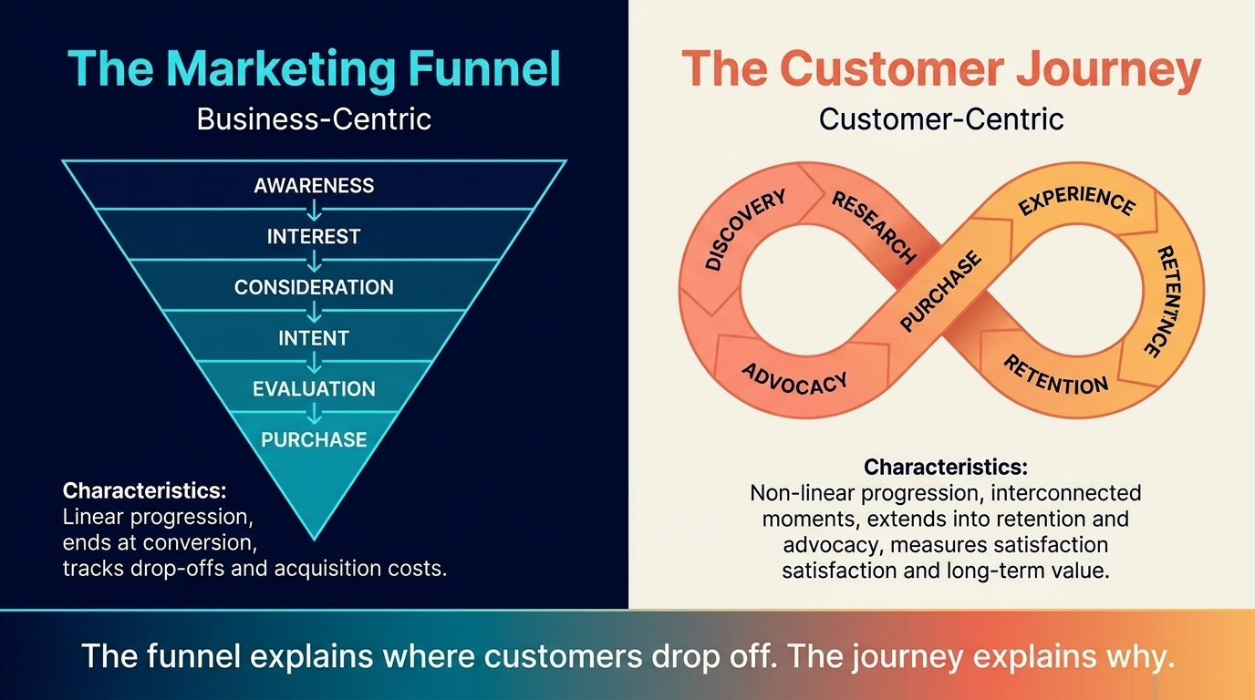
LU2 · TWO MENTAL MODELS
The Marketing Funnel vs the Customer Journey
The funnel explains where customers drop off; the journey explains why.
Customer-Centric Branding and Communication Tactics · TGS-2026061321
© 2026 Tertiary Infotech Academy Pte Ltd
28

Slide 30
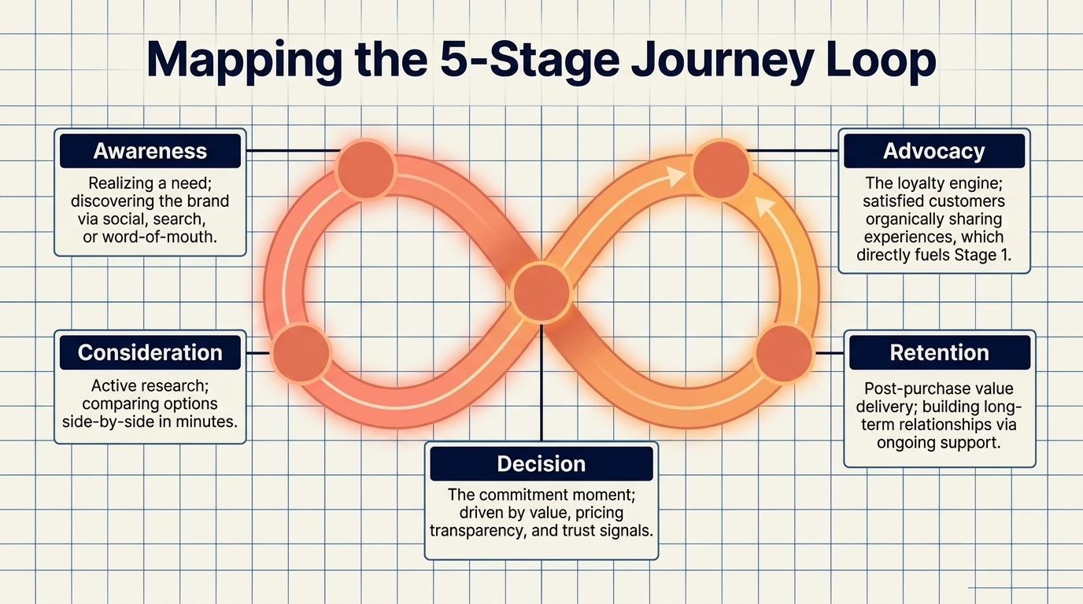
LU2 · THE JOURNEY LOOP
Mapping the 5-Stage Journey Loop
Awareness → Consideration → Decision → Retention → Advocacy — and advocacy feeds awareness again.
Customer-Centric Branding and Communication Tactics · TGS-2026061321
© 2026 Tertiary Infotech Academy Pte Ltd
29

Slide 31
LU2 · EMOTION DRIVES PERCEPTION
The Engine of Loyalty: Emotional Branding
Affect-driven purchasing decisions outpace purely rational choices.
45.2%
42%
88.1%
say an emotional connection with a brand is very important
associate their favourite brands with trust & reliability
actively choose branded products over non-branded alternatives
55% of loyalty is driven by quality — but 32% is driven entirely by customer service and emotional support.
Customer-Centric Branding and Communication Tactics · TGS-2026061321
© 2026 Tertiary Infotech Academy Pte Ltd
30

Slide 32
WHAT YOU'LL DO
In-Class Activities — Customer Influence
Activities 5–6
Activities 7–8
• Brand Perception Audit
• Brand Advocacy Assessment
• Campaign Documentation Audit
• Customer Perspective Analysis
Customer-Centric Branding and Communication Tactics · TGS-2026061321
© 2026 Tertiary Infotech Academy Pte Ltd
31

Slide 33
LU2 · ACTIVITY 5
Brand Perception Audit
ACTIVITY 5
Your company recently received mixed customer reviews. Management believes service quality is excellent, but customer-satisfaction scores are declining. Conduct a perception audit to identify the gaps.
WORKFLOW
1
2
3
4
Survey 20 recent customers about their service experience.
▶
Compare internal quality metrics with the customer feedback.
▶
Identify the top 3 perception gaps.
▶
Develop an action plan to address the gaps.
YOU'LL PRODUCE
Duration
25 minutes
A perception-gap analysis report comparing internal quality metrics with customer feedback
Customer-Centric Branding and Communication Tactics · TGS-2026061321
© 2026 Tertiary Infotech Academy Pte Ltd
32

Slide 34
LU2 · ACTIVITY 6
Brand Advocacy Assessment
ACTIVITY 6
Your company recently received mixed reviews online. As brand manager, analyse customer feedback and develop an advocacy strategy to improve brand reputation through existing satisfied customers.
WORKFLOW
1
2
3
4
Review the provided customer feedback data.
▶
Identify satisfied customers for the advocacy programme.
▶
Design an advocacy campaign that leverages their positive experiences.
▶
Present the strategy together with its expected impact metrics.
YOU'LL PRODUCE
Duration
25 minutes
A customer-advocacy strategy document with target impact metrics
Customer-Centric Branding and Communication Tactics · TGS-2026061321
© 2026 Tertiary Infotech Academy Pte Ltd
33

Slide 35
LU2 · ACTIVITY 7
Campaign Documentation Audit
ACTIVITY 7
Your company launched a new product branding campaign three months ago. Management needs a documentation report on customer reception and campaign outcomes to inform future marketing investment.
WORKFLOW
1
2
3
4
Identify three key metrics from the campaign data.
▶
Analyse customer feedback patterns and sentiment trends.
▶
Create a documentation framework for ongoing measurement.
▶
Present the findings with actionable recommendations.
YOU'LL PRODUCE
Duration
25 minutes
A structured campaign-reception report with metrics, analysis and optimisation recommendations
Customer-Centric Branding and Communication Tactics · TGS-2026061321
© 2026 Tertiary Infotech Academy Pte Ltd
34

Slide 36
LU2 · ACTIVITY 8
Customer Perspective Analysis
ACTIVITY 8
You receive a complaint from a long-term customer expressing frustration about recent service changes. They say they feel 'unheard' and 'unimportant' to your organisation.
WORKFLOW
1
2
3
4
Apply the 3 P's framework — Presence, Patience, Paraphrasing — during the conversation.
▶
Identify the emotions behind the customer's specific words.
▶
Paraphrase the customer's perspective back to them without judgement.
▶
Document the insights for strategic decision-making.
YOU'LL PRODUCE
Duration
25 minutes
A completed customer-perspective analysis report with actionable insights
Customer-Centric Branding and Communication Tactics · TGS-2026061321
© 2026 Tertiary Infotech Academy Pte Ltd
35

Slide 37
LU2 RECAP
Recap — Customer Influence
Brand Perception Audit
You can now: Assess customer perceptions of the brand, products and services.
Brand Advocacy Assessment
You can now: Recognise the importance of the customer in influencing brand reputation.
1
2
Campaign Documentation Audit
You can now: Document customer reception to the brand and the outcome of branding campaigns.
Customer Perspective Analysis
You can now: Perform active listening from the customer to understand the customer's perspective of the organisation.
3
4
Customer-Centric Branding and Communication Tactics · TGS-2026061321
© 2026 Tertiary Infotech Academy Pte Ltd
36

Slide 38
LU3
LU3
Branding in Marketing
Branding Basics · Role in Marketing · Awareness Campaigns · PR Execution
Customer-Centric Branding and Communication Tactics · TGS-2026061321
© 2026 Tertiary Infotech Academy Pte Ltd
37

Slide 39
LU3 · KEY CONCEPTS
Key Concepts — Branding in Marketing
Branding basics — visual identity, brand values, brand voice and brand guidelines — give a business a consistent, recognisable presence.
Branding plays a central role in marketing: it builds trust, differentiates from competitors and creates the emotional connection that drives loyalty.
1
2
Executing branding campaigns, events and activities — from social pushes to experiential pop-ups — raises brand awareness across the target audience.
Public-relations campaigns must align to the brand positioning strategy, the operational plan and the marketing budget to stay credible and sustainable.
3
4
Customer-Centric Branding and Communication Tactics · TGS-2026061321
© 2026 Tertiary Infotech Academy Pte Ltd
38

Slide 40
LU3 · AUTHENTICITY
The Anatomy of Brand Authenticity
Authenticity is engineered through four repeatable practices.
Radical Transparency
Value Alignment
Open communication about business practices and product origins — e.g. Patagonia's Footprint Chronicles detailing supply-chain realities.
Emotional connection forged through shared beliefs and societal commitment — e.g. Ben & Jerry's integration of social justice into core operations.
Authentic Storytelling
Quality Assurance
Humanising the brand through relatable, non-fabricated narratives — e.g. Nike highlighting genuine struggles and triumphs of real athletes.
Trust earned through unwavering consistency and reliability — e.g. Toyota's rigorous quality control building global dependability.
Customer-Centric Branding and Communication Tactics · TGS-2026061321
© 2026 Tertiary Infotech Academy Pte Ltd
39

Slide 41
LU3 · WHAT BREAKS TRUST
The Trust Fracture: the Say-Do Gap
How trust fractures
Case: the Volkswagen emissions scandal
• Brand authenticity is destroyed by inauthentic practices — when a company's actions contradict its stated promises.
• Discrepancies between marketing claims and operational reality create a trust fracture that severs the customer journey loop permanently.
• PR campaigns can only amplify what operations can prove.
• Software was installed to cheat emissions tests.
• The deception directly contradicted public claims of environmental responsibility.
• Result: immediate, catastrophic loss of consumer trust — a say-do gap no campaign could repair.
Customer-Centric Branding and Communication Tactics · TGS-2026061321
© 2026 Tertiary Infotech Academy Pte Ltd
40

Slide 42
WHAT YOU'LL DO
In-Class Activities — Branding in Marketing
Activities 9–10
Activities 11–12
• Brand Audit Workshop
• Brand-Marketing Audit Exercise
• Brand Activation Planning Workshop
• PR Campaign Budget Planning
Customer-Centric Branding and Communication Tactics · TGS-2026061321
© 2026 Tertiary Infotech Academy Pte Ltd
41

Slide 43
LU3 · ACTIVITY 9
Brand Audit Workshop
ACTIVITY 9
You are consulting for a local restaurant with inconsistent branding across their website, social media, and physical location. The owner wants to understand how to create unified brand guidelines.
WORKFLOW
1
2
3
4
5
Analyse the current brand touchpoints and identify inconsistencies.
▶
Define the core brand values and a mission statement.
▶
Create visual identity specifications — logo and colours.
▶
Develop brand-voice guidelines for customer communication.
▶
Design an implementation plan with specific application examples.
YOU'LL PRODUCE
Duration
30 minutes
A brand-guidelines document — visual standards, voice guidelines and an implementation roadmap
Customer-Centric Branding and Communication Tactics · TGS-2026061321
© 2026 Tertiary Infotech Academy Pte Ltd
42

Slide 44
LU3 · ACTIVITY 10
Brand-Marketing Audit Exercise
ACTIVITY 10
You are a marketing manager evaluating how well your company's current marketing campaigns align with brand identity. Select a real company and analyse one of their recent marketing campaigns.
WORKFLOW
1
2
3
4
Choose a brand and identify its core identity elements.
▶
Analyse one recent marketing campaign for brand consistency.
▶
Evaluate the alignment between the brand messaging and the campaign goals.
▶
Identify gaps and propose improvements for better integration.
YOU'LL PRODUCE
Duration
20 minutes
A brand-audit report with a consistency assessment and recommendations
Customer-Centric Branding and Communication Tactics · TGS-2026061321
© 2026 Tertiary Infotech Academy Pte Ltd
43

Slide 45
LU3 · ACTIVITY 11
Brand Activation Planning Workshop
ACTIVITY 11
Your organisation wants to launch a new product line and needs to increase brand awareness by 40% within 6 months. Design a multi-channel campaign that includes both digital and experiential elements.
WORKFLOW
1
2
3
4
5
Define the target audience's demographics and psychographics.
▶
Develop a core brand message aligned with the audience's values.
▶
Select 3–4 marketing channels and design consistent visuals across them.
▶
Plan one experiential event and its supporting digital content.
▶
Create a measurement framework using brand-recall metrics.
YOU'LL PRODUCE
Duration
30 minutes
A campaign-strategy document with timeline, budget allocation and success metrics
Customer-Centric Branding and Communication Tactics · TGS-2026061321
© 2026 Tertiary Infotech Academy Pte Ltd
44

Slide 46
LU3 · ACTIVITY 12
PR Campaign Budget Planning
ACTIVITY 12
You're the marketing manager for a growth-stage tech company launching a new product. Create a PR campaign budget aligned with the brand positioning strategy.
WORKFLOW
1
2
3
4
Define three core content pillars for the brand.
▶
Allocate 15% of the marketing budget to PR activities.
▶
Distribute the PR budget across earned, owned and paid channels.
▶
Identify the key performance indicators for measurement.
YOU'LL PRODUCE
Duration
25 minutes
A PR budget proposal with channel allocation and success metrics
Customer-Centric Branding and Communication Tactics · TGS-2026061321
© 2026 Tertiary Infotech Academy Pte Ltd
45

Slide 47
LU3 RECAP
Recap — Branding in Marketing
Brand Audit Workshop
You can now: Explain the basics of branding.
Brand-Marketing Audit Exercise
You can now: Explain the role of branding in marketing.
1
2
Brand Activation Planning Workshop
You can now: Execute branding campaigns, events and activities to increase brand awareness.
PR Campaign Budget Planning
You can now: Execute public-relations campaigns in alignment to brand positioning strategies, operational plans and budget.
3
4
Customer-Centric Branding and Communication Tactics · TGS-2026061321
© 2026 Tertiary Infotech Academy Pte Ltd
46

Slide 48
LU4
LU4
Branding Effectiveness
Reputation Metrics · Success Indicators · PR Tactics · KPI Monitoring · Continuous Improvement
Customer-Centric Branding and Communication Tactics · TGS-2026061321
© 2026 Tertiary Infotech Academy Pte Ltd
47

Slide 49
LU4 · KEY CONCEPTS
Key Concepts — Branding Effectiveness
Reputation is measured through social metrics, digital metrics (traffic, mentions) and business KPIs (NPS, satisfaction) across every platform the organisation touches.
Successful branding shows up in awareness, customer loyalty, financial impact and trust metrics — tracked consistently over time, not measured once.
1
2
Public-relations tactics — media relations, community outreach, crisis management and digital engagement — extend the brand's message beyond paid channels.
Monitoring the brand against SMART KPIs and acting on the gaps turns brand management into a continuous-improvement cycle rather than a one-off campaign.
3
4
Customer-Centric Branding and Communication Tactics · TGS-2026061321
© 2026 Tertiary Infotech Academy Pte Ltd
48

Slide 50
LU4 · THE NEXT FRONTIER: AGENTIC AI
“The agent is becoming the brand.”
Nine in ten US marketing agencies now use generative AI, and half use agentic AI for execution. AI is no longer just generating content — it is deciding, spending, personalising and interacting directly with customers.
Customer-Centric Branding and Communication Tactics · TGS-2026061321
© 2026 Tertiary Infotech Academy Pte Ltd
49

Slide 51
LU4 · AI BRAND RISK
The Risk Vector: Authority Concentration
1
2
3
4
▶
▶
▶
Content agent — permission to draft copy + access the CMS
Media agent — permission to optimise spend + finance workflows
Personalisation engine — tailors experiences + sensitive data
Concentration node — combined permissions create high risk
In an agentic enterprise, risk moves through authority pathways, not people. Human approvals cannot scale at machine speed to monitor these intersections.
Customer-Centric Branding and Communication Tactics · TGS-2026061321
© 2026 Tertiary Infotech Academy Pte Ltd
50

Slide 52
LU4 · GOVERNANCE
The Brand Authority Model
1
2
3
4
5
▶
▶
▶
▶
Identity — which human and non-human identities can act on behalf of the brand?
Access — what systems, data and workflows are they permitted to touch?
Inheritance — what authority do they hold after delegation and integrations?
Concentration — where does authority unintentionally combine into high risk?
Revocation — how quickly can authority be severed if boundaries are breached?
Enterprise Authority Assurance replaces the editorial calendar.
Customer-Centric Branding and Communication Tactics · TGS-2026061321
© 2026 Tertiary Infotech Academy Pte Ltd
51

Slide 53
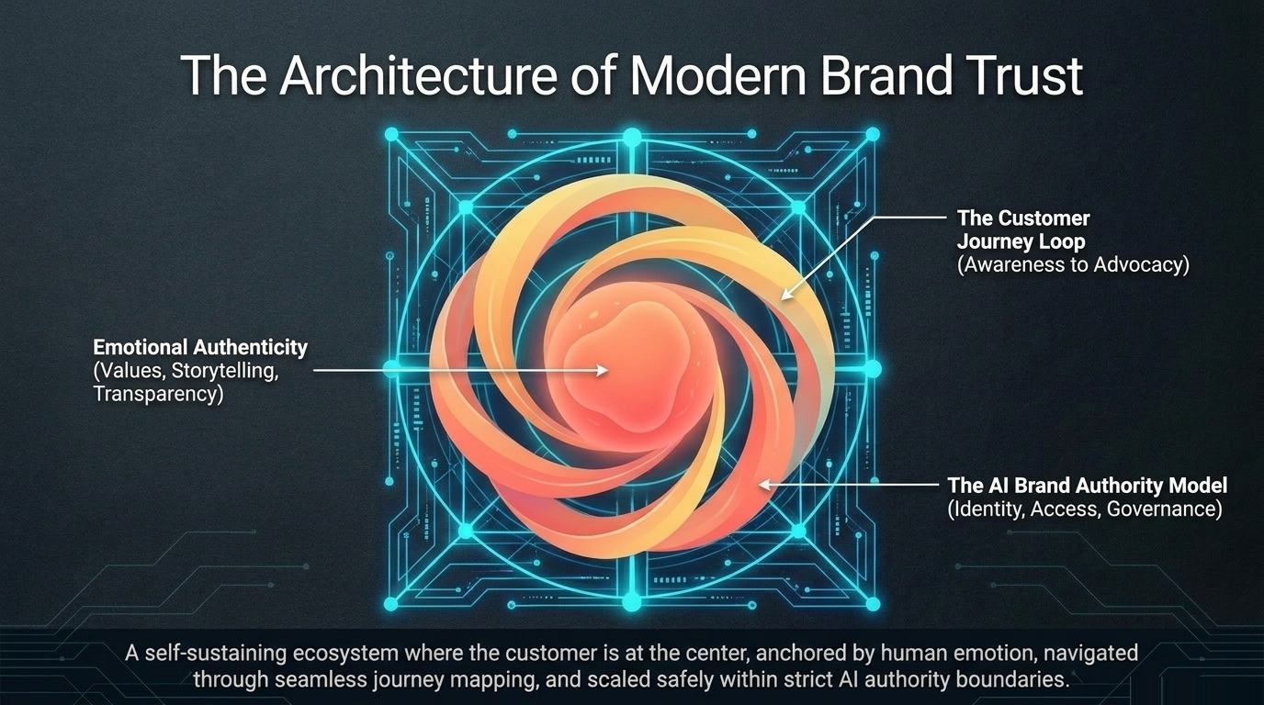
LU4 · PUTTING IT TOGETHER
The Architecture of Modern Brand Trust
The customer at the centre — anchored by emotion, navigated through journey mapping, scaled safely within strict AI authority boundaries.
Customer-Centric Branding and Communication Tactics · TGS-2026061321
© 2026 Tertiary Infotech Academy Pte Ltd
52

Slide 54
LU4 · FROM INSIGHT TO ACTION
The Executive Playbook
01
02
03
04
Shift the Metric
Map the Reality, Not the Theory
Close the Say-Do Gap
Build the Authority Model
Move away from pure acquisition costs. Restructure KPIs around lifetime value, Net Promoter Scores and journey retention.
Audit the 5-stage customer journey loop using actual behavioural data, not internal corporate assumptions. Find the friction.
Audit your brand's authenticity. Ensure marketing claims — environmental, social, quality — are rigidly matched by operational reality.
Stop relying on human bottlenecks for AI approval. Map identity, access and authority concentration for every agentic system touching your brand.
Trust cannot be retrofitted. It must be engineered.
Customer-Centric Branding and Communication Tactics · TGS-2026061321
© 2026 Tertiary Infotech Academy Pte Ltd
53

Slide 55
WHAT YOU'LL DO
In-Class Activities — Branding Effectiveness
Activities 13–14
Activities 15–16
Activities 17–17
• Platform Reputation Audit
• Brand Health Assessment
• PR Crisis Response Plan
• KPI Dashboard Design
• PR Campaign Audit Exercise
Customer-Centric Branding and Communication Tactics · TGS-2026061321
© 2026 Tertiary Infotech Academy Pte Ltd
54

Slide 56
LU4 · ACTIVITY 13
Platform Reputation Audit
ACTIVITY 13
Your organisation needs to establish reputation monitoring for a new product launch across social media, review sites, and business platforms.
WORKFLOW
1
2
3
4
Map the stakeholder groups and select 3 key platforms per group.
▶
Define specific KPIs for the social, digital and business indicators.
▶
Set up monitoring tools and establish baseline measurements.
▶
Create a weekly reporting dashboard showing sentiment trends.
YOU'LL PRODUCE
Duration
20 minutes
A reputation-monitoring framework with defined metrics and tracking systems
Customer-Centric Branding and Communication Tactics · TGS-2026061321
© 2026 Tertiary Infotech Academy Pte Ltd
55

Slide 57
LU4 · ACTIVITY 14
Brand Health Assessment
ACTIVITY 14
You are a marketing manager evaluating your company's brand performance using both traditional and digital metrics.
WORKFLOW
1
2
3
4
Select 3 key metrics from the awareness, loyalty and performance categories.
▶
Design a measurement approach that combines survey and digital analytics.
▶
Create a monthly tracking dashboard with benchmarks.
▶
Present the findings with actionable recommendations.
YOU'LL PRODUCE
Duration
25 minutes
A brand-health scorecard with metric definitions, current performance and an improvement plan
Customer-Centric Branding and Communication Tactics · TGS-2026061321
© 2026 Tertiary Infotech Academy Pte Ltd
56

Slide 58
LU4 · ACTIVITY 15
PR Crisis Response Plan
ACTIVITY 15
Your company faces negative social-media coverage about product-quality issues. Design a comprehensive PR response strategy using the tactics learned.
WORKFLOW
1
2
3
4
5
Identify the affected stakeholder groups and media outlets.
▶
Develop core messaging that addresses the concerns transparently.
▶
Create a media-outreach plan with personalised pitches.
▶
Design the social-media response and community-engagement plan.
▶
Establish measurement metrics for reputation recovery.
YOU'LL PRODUCE
Duration
25 minutes
A crisis-communication plan with timelines and responsible parties
Customer-Centric Branding and Communication Tactics · TGS-2026061321
© 2026 Tertiary Infotech Academy Pte Ltd
57

Slide 59
LU4 · ACTIVITY 16
KPI Dashboard Design
ACTIVITY 16
Create a brand KPI monitoring framework for a retail company launching new product lines.
WORKFLOW
1
2
3
Select 3 internal and 3 external KPIs.
▶
Define the measure, target, data source and frequency for each KPI.
▶
Design a monthly tracking dashboard.
YOU'LL PRODUCE
Duration
20 minutes
A complete KPI framework with a tracking schedule
Customer-Centric Branding and Communication Tactics · TGS-2026061321
© 2026 Tertiary Infotech Academy Pte Ltd
58

Slide 60
LU4 · ACTIVITY 17
PR Campaign Audit Exercise
ACTIVITY 17
Your organisation's recent product-launch campaign achieved 500K impressions but only 15% top-tier coverage and 45% message penetration. Stakeholders are questioning the campaign's business impact.
WORKFLOW
1
2
3
Apply the AMEC framework to identify the performance gaps.
▶
Develop three strategic recommendations using best practice.
▶
Create a measurement plan with specific KPIs.
YOU'LL PRODUCE
Duration
25 minutes
An improvement proposal with metrics, built using the AMEC measurement framework
Customer-Centric Branding and Communication Tactics · TGS-2026061321
© 2026 Tertiary Infotech Academy Pte Ltd
59

Slide 61
LU4 RECAP
Recap — Branding Effectiveness
Platform Reputation Audit
You can now: Identify measures or indicators of the organisation's reputation on different platforms.
Brand Health Assessment
You can now: Recognise the indicators of successful branding.
1
2
PR Crisis Response Plan
You can now: Apply public-relations tactics.
KPI Dashboard Design
You can now: Monitor the success of the brand against Key Performance Indicators (KPI).
3
4
PR Campaign Audit Exercise
You can now: Provide suggestions to improve public-relations campaign effectiveness.
5
Customer-Centric Branding and Communication Tactics · TGS-2026061321
© 2026 Tertiary Infotech Academy Pte Ltd
60

Slide 62
WRAP-UP
Course Summary & Next Steps
Customer-Centric Branding and Communication Tactics · TGS-2026061321
© 2026 Tertiary Infotech Academy Pte Ltd
61

Slide 63
LEARNING OUTCOMES
What You Achieved
Stakeholders & Organisation
Mapped stakeholders and audiences; drafted brand designs and reputation assessments.
Customer Influence
Captured and documented customer perception through active listening.
1
2
Branding in Marketing
Executed branding and PR campaigns aligned to strategy, plan and budget.
Branding Effectiveness
Measured reputation and PR performance against KPIs and proposed improvements.
3
4
Customer-Centric Branding and Communication Tactics · TGS-2026061321
© 2026 Tertiary Infotech Academy Pte Ltd
62

Slide 64
WRAP-UP
Assessment
• Written Assessment (WA, SAQ) — 1 hour. Case Study (CS) — 1 hour.
• Open book: slides, Learner Guide and approved materials only.
• Remember to complete the TRAQOM survey and take the Assessment digital attendance (two separate steps).
• Submit your completed answers on the LMS at https://lms-tms.tertiaryinfotech.com/.
Customer-Centric Branding and Communication Tactics · TGS-2026061321
© 2026 Tertiary Infotech Academy Pte Ltd
63

Slide 65
ON ASSESSMENT DAY
Assessment Flow
1
2
3
4
5
▶
▶
▶
▶
TRAQOM survey — scan the QR code on the LMS
Assessment digital attendance — scan the SSG QR
Sit WA (SAQ) then the Case Study — open book
Submit your answers on the LMS
Sign the Assessment Summary Record
Customer-Centric Branding and Communication Tactics · TGS-2026061321
© 2026 Tertiary Infotech Academy Pte Ltd
64

Slide 66
SSG DIGITAL ATTENDANCE
Digital Attendance (Mandatory)
• It is mandatory to take the AM, PM and Assessment digital attendance for WSQ-funded courses.
• The trainer/administrator displays the digital attendance QR code from the SSG portal.
• Scan the QR code with your mobile phone camera and submit your attendance.
• A minimum of 75% attendance is required to be eligible for assessment and funding.
Customer-Centric Branding and Communication Tactics · TGS-2026061321
© 2026 Tertiary Infotech Academy Pte Ltd
65

Slide 67
SEE YOU AT THE NEXT ONE
Thank You!
You are now equipped to build customer-centric brand communication that earns trust and drives results.
Customer-Centric Branding and Communication Tactics · TGS-2026061321
© 2026 Tertiary Infotech Academy Pte Ltd
66

